Slide 1
Image Classification and Object Detection
Week 5

Slide 2
Learning Outcomes
By the end of this week, you will be able to:
Describe image classification principles,
Compare object detection models,
Implement an object detection model on a dataset.

Slide 3
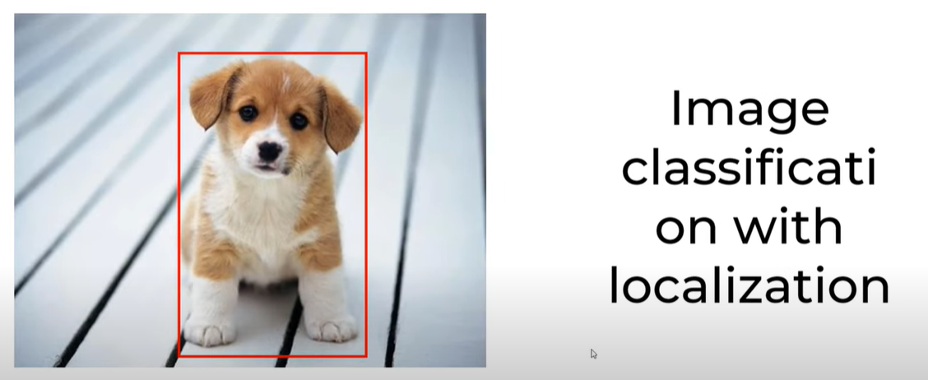
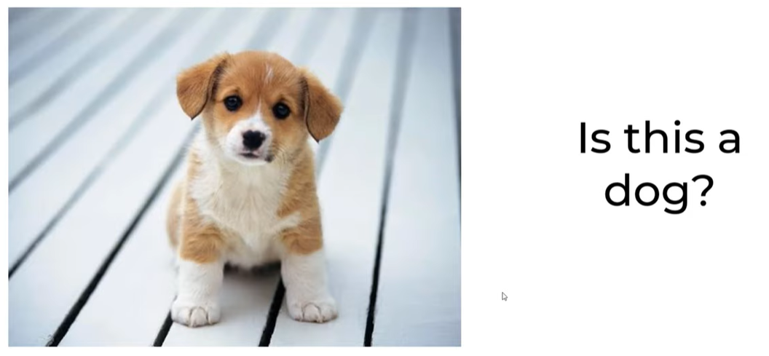

Slide 4
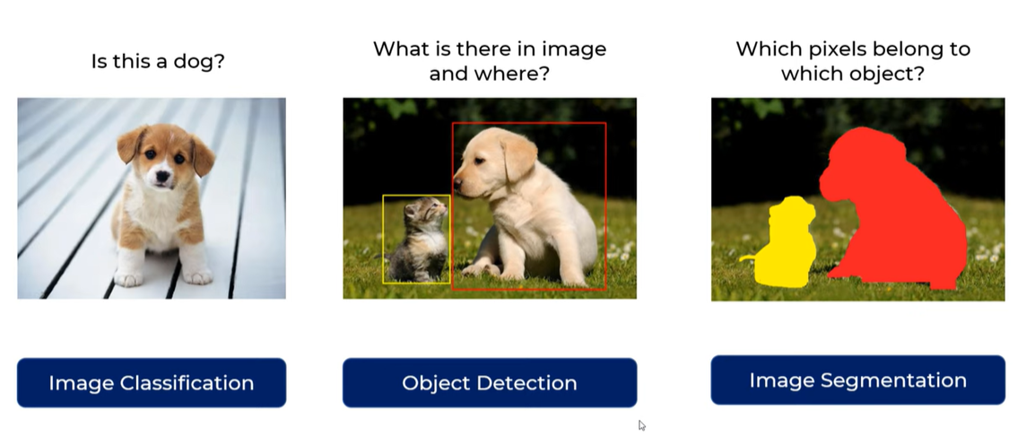
Notes:
Object detection extends image classification by identifying both the class and location of objects in an image. It outputs bounding boxes around detected objects and assigns labels to them.
Key Concepts in Object Detection:
Region Proposals: Identifying regions in an image that may contain objects.
Feature Extraction: Using CNNs to extract spatial features.
Bounding Box Regression: Predicting object location.

Slide 5
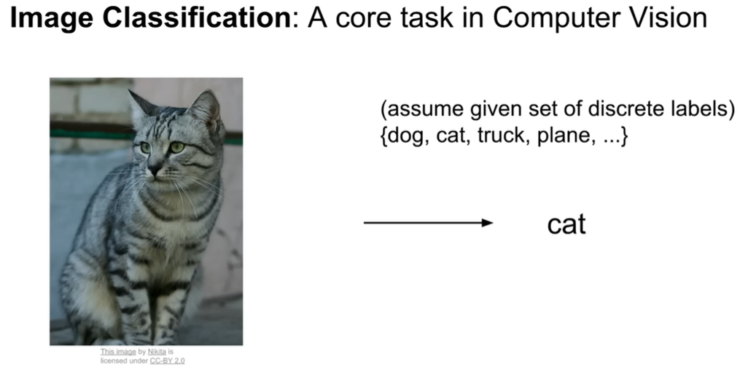
Image classification is the task of assigning a label to an image based on its content.
It involves training a model to recognize patterns and features from images and categorize them into predefined classes.

Slide 6
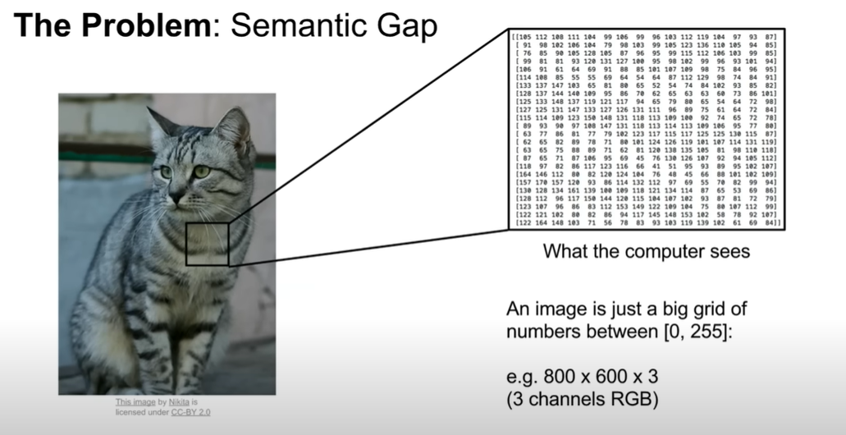

Slide 7
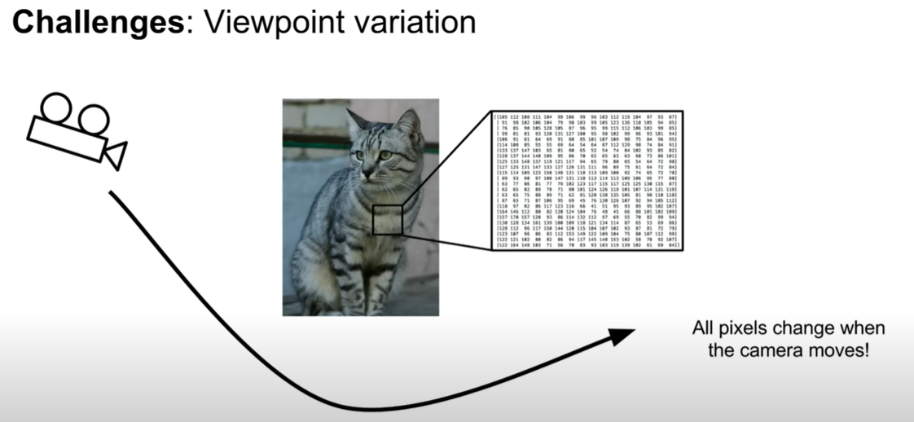

Slide 8
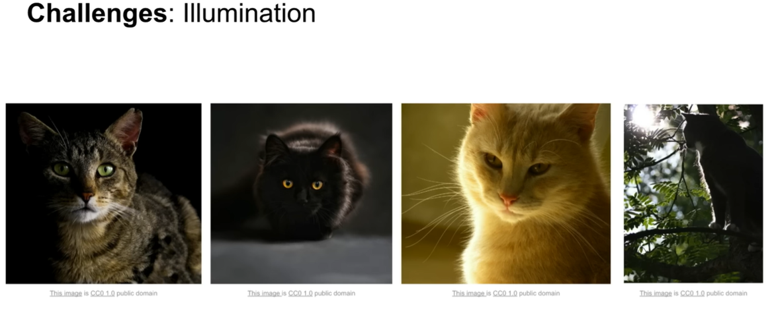

Slide 9
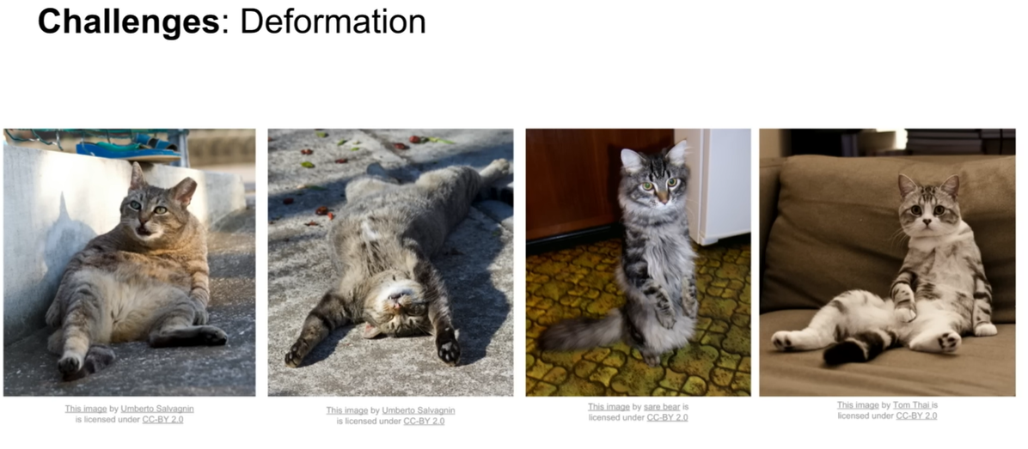
The algorithms need to be robust to these various forms of deformations

Slide 10
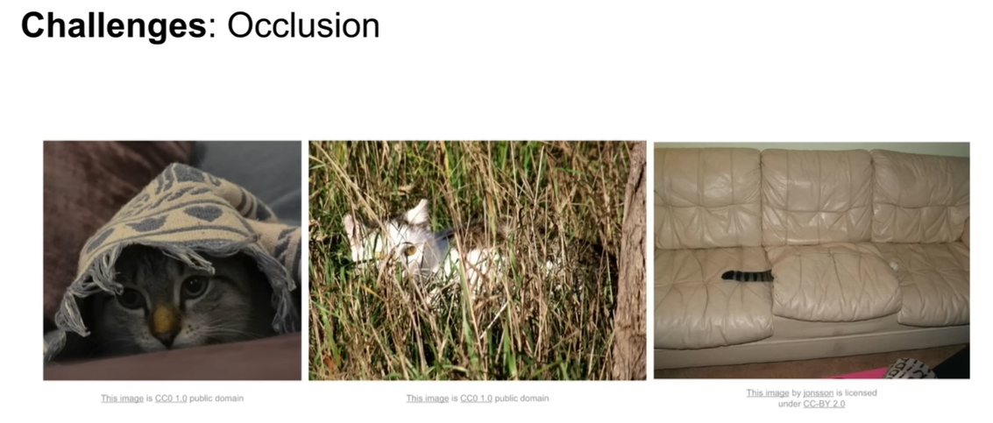
When you only see a part of the cat, but is quite difficult for an algorithm

Slide 11
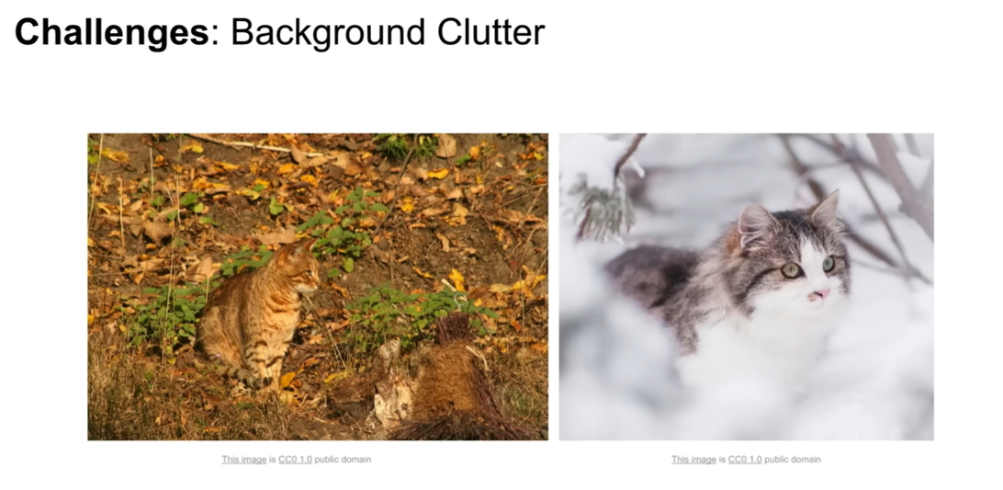

Slide 12
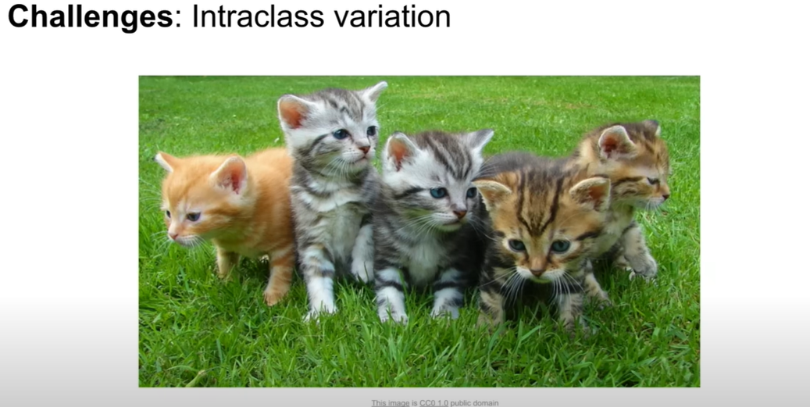
Cats come in different shapes and colors. The algorithm needs to handle these variations

Slide 13
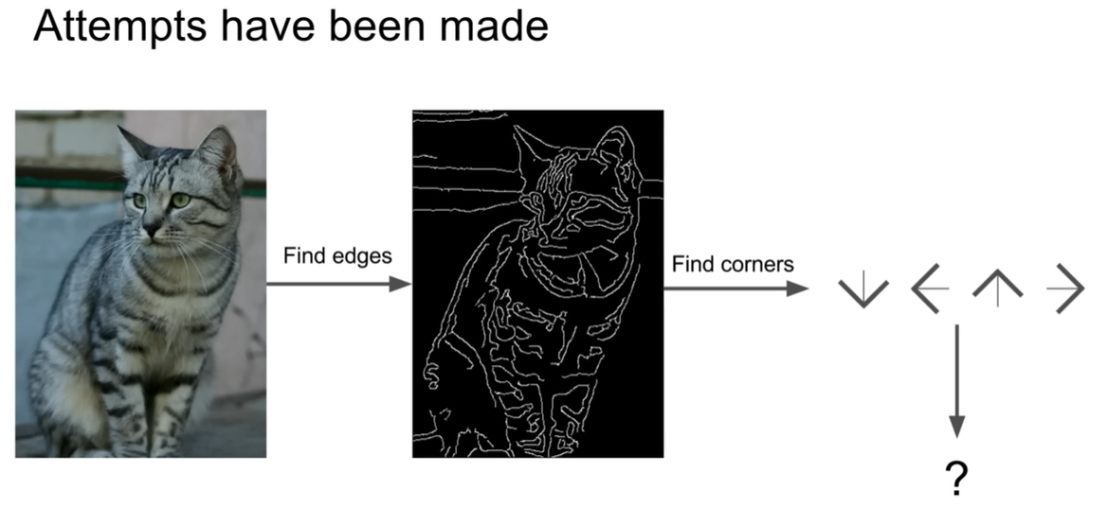
Feature Extraction: Identifying patterns such as edges, shapes, and textures.

Slide 14
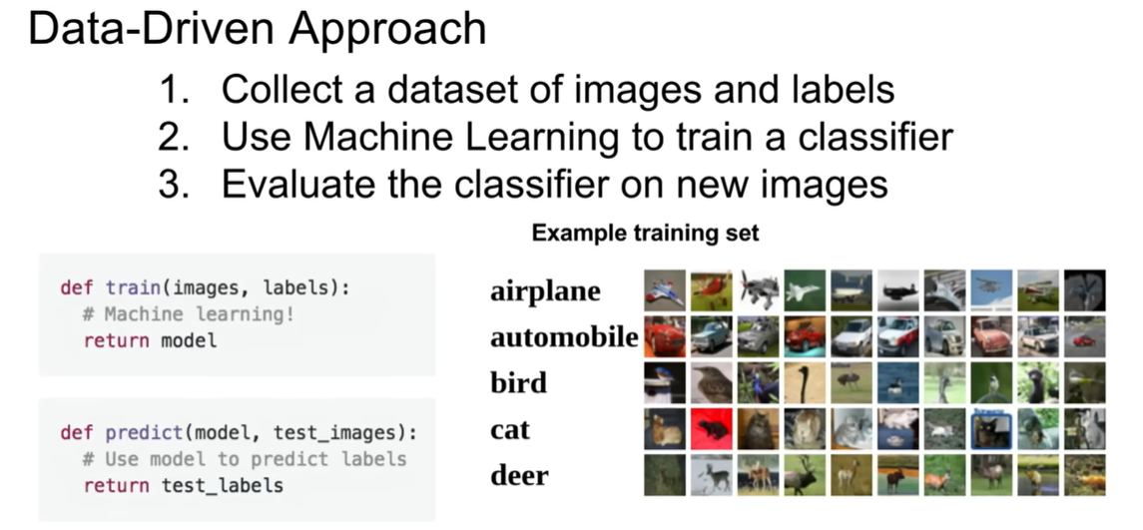

Slide 15
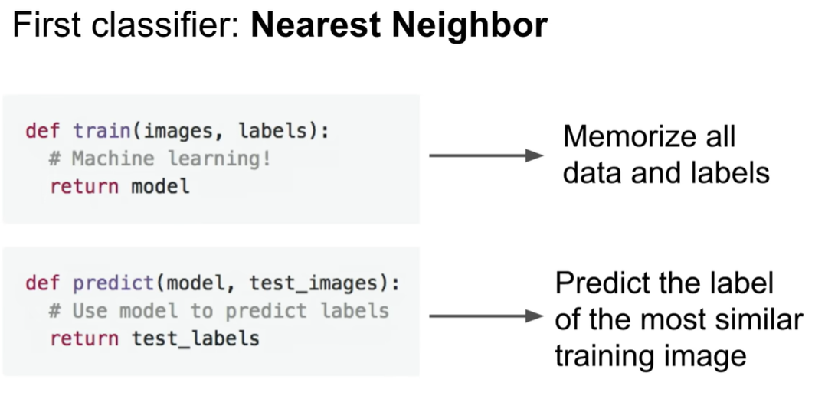

Slide 16
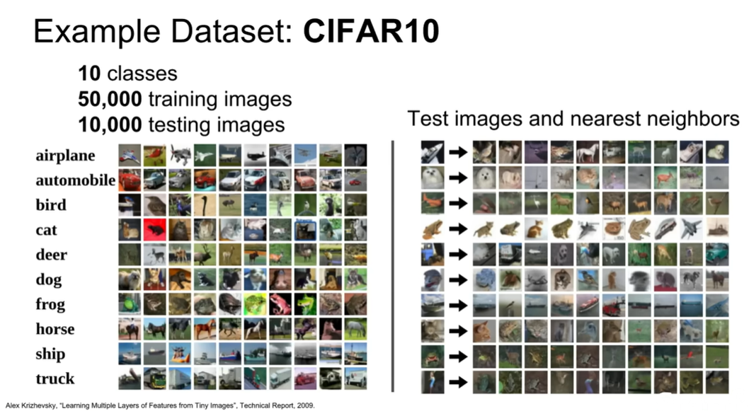

Slide 17
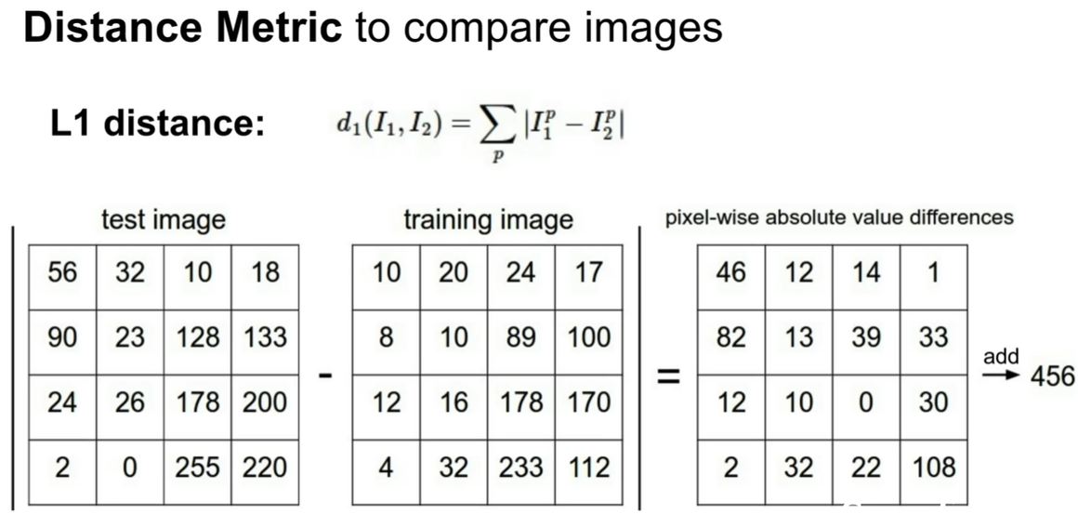

Slide 18
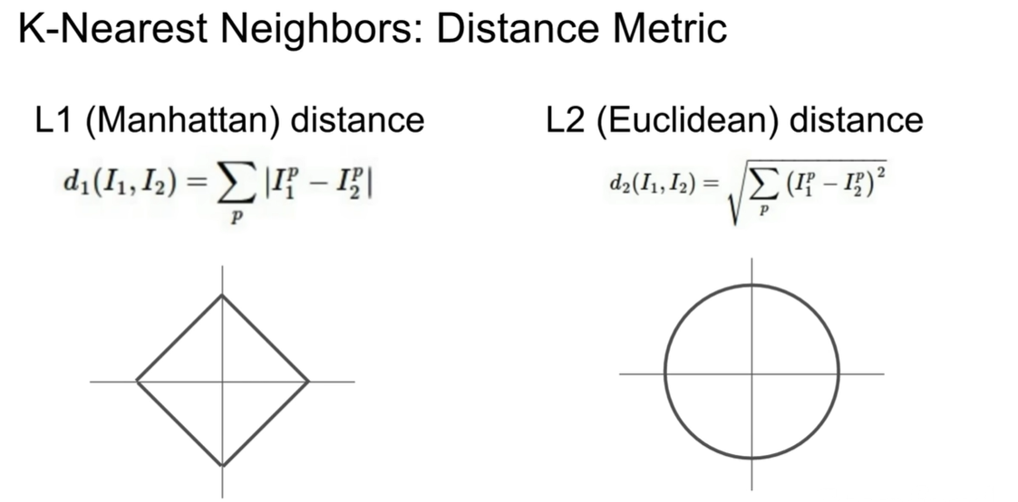

Slide 19
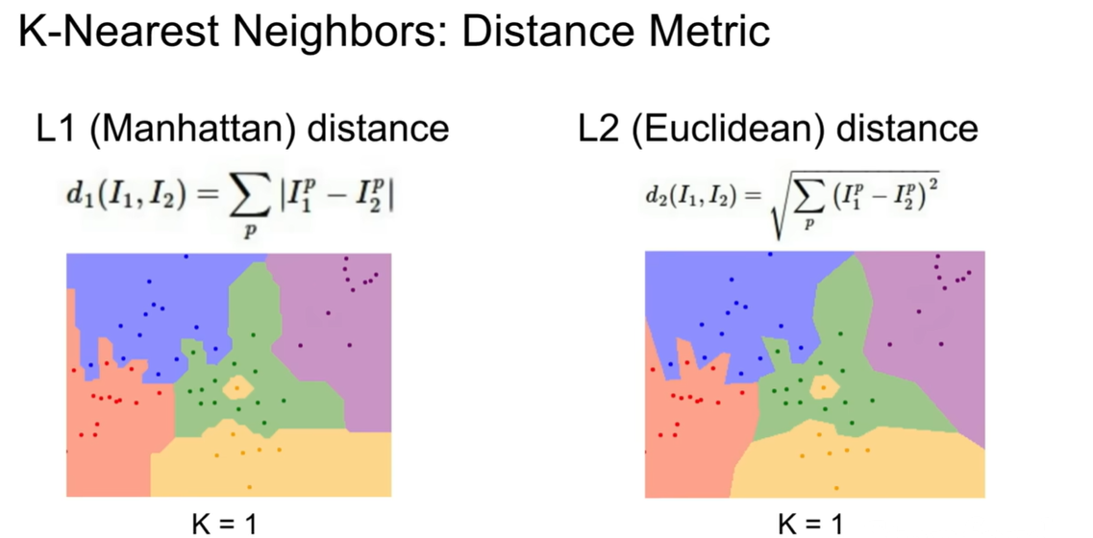

Slide 20
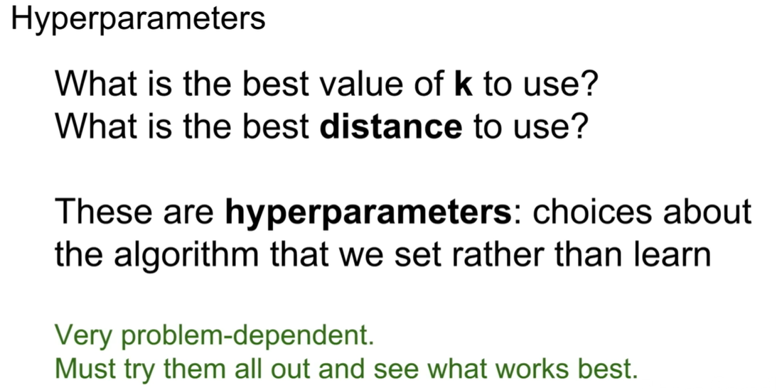

Slide 21
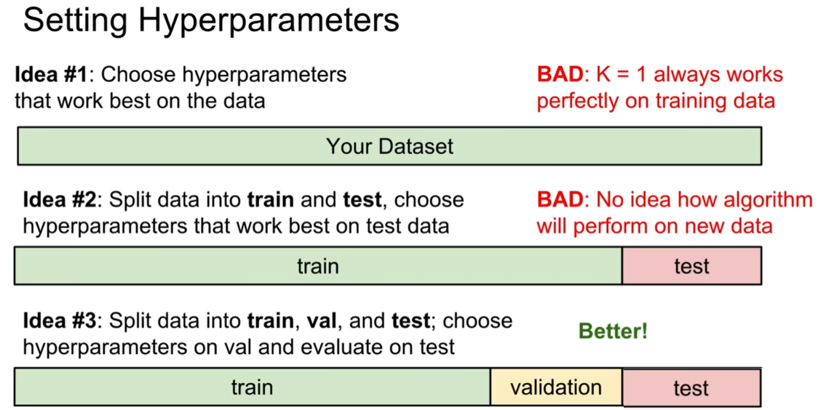

Slide 22
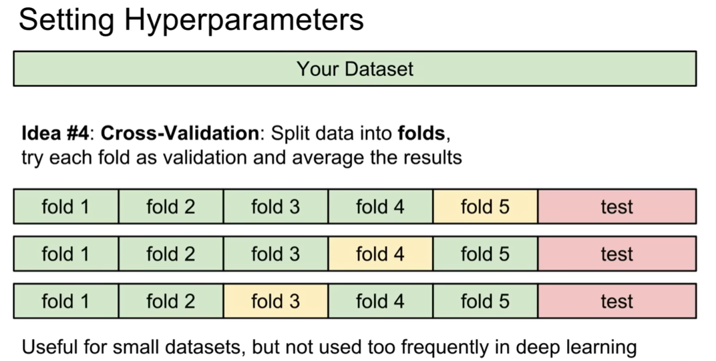

Slide 23
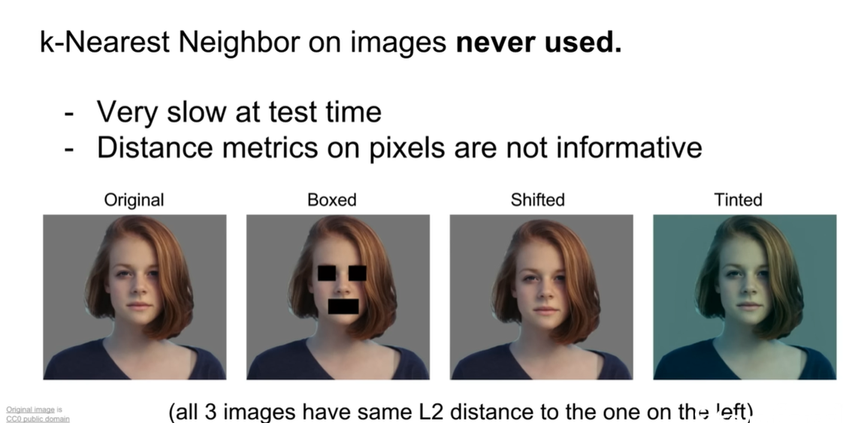

Slide 24
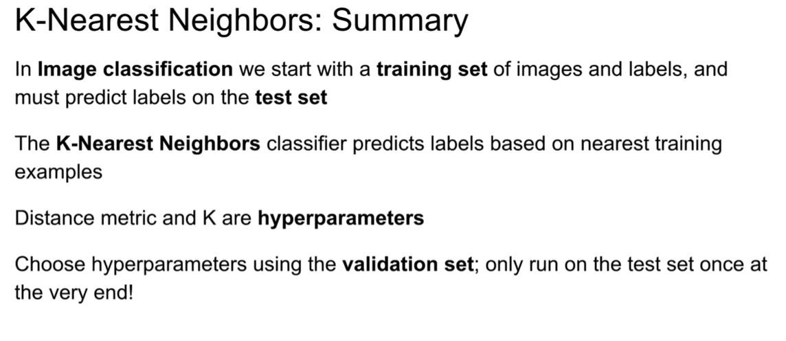

Slide 25
Linear Classifier
The building blocks of neural networks and convolutional neural network

Slide 26
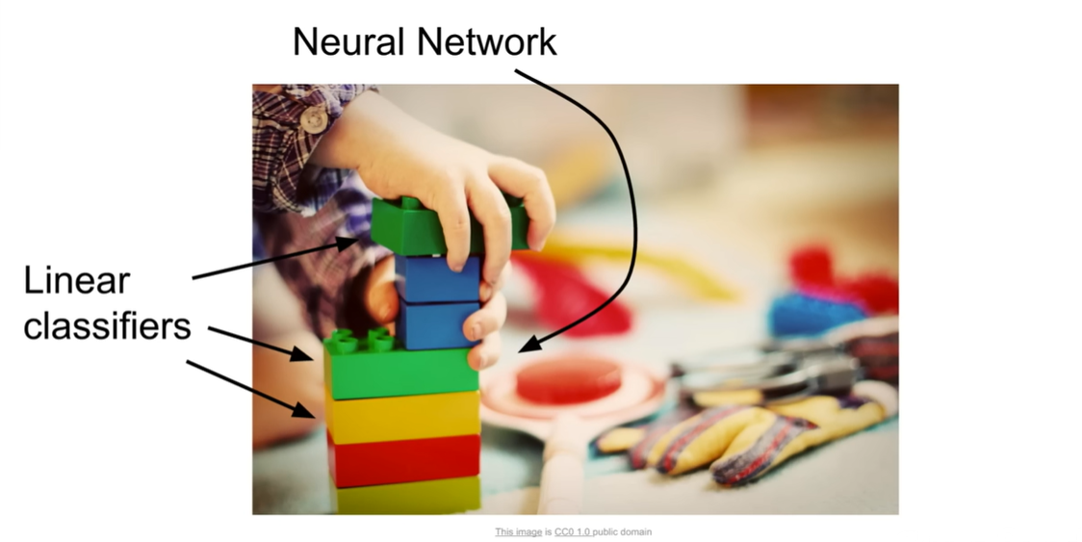

Slide 27
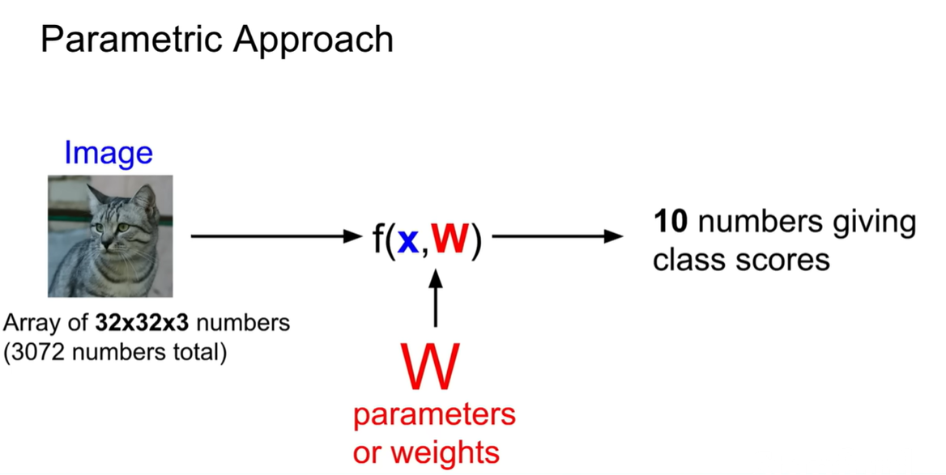

Slide 28
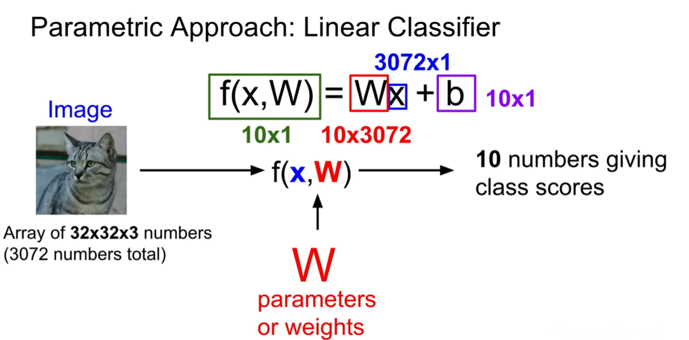
10 categories in CIFAR10

Slide 29
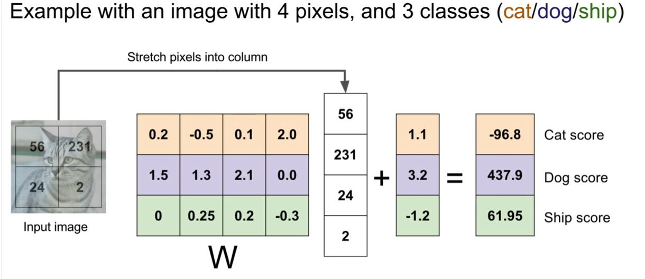
4 pixels by 3 classes (can’t fit all the 10 classes here)

Slide 30
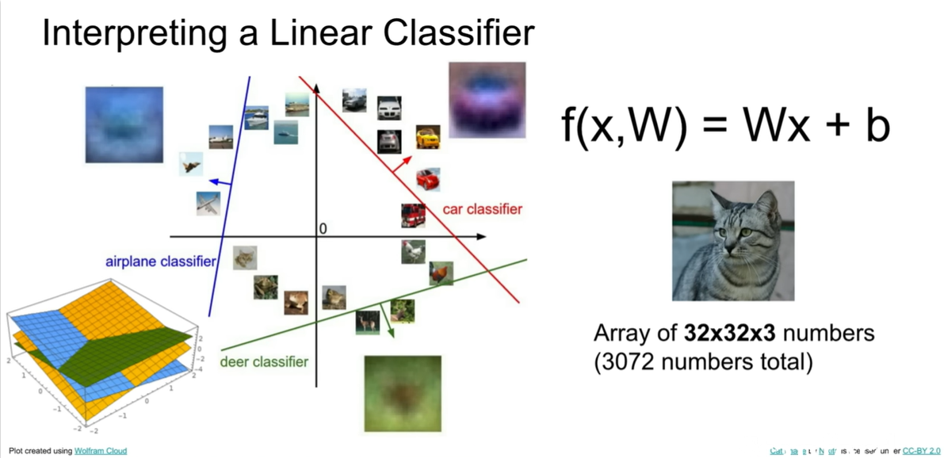

Slide 31
Convolutional Neural Networks (CNNs) Using convolutional layers to detect hierarchical features.

Slide 32
Steps in Image Classification using CNNs
Preprocessing: Resize images, normalize pixel values, and augment data.
Feature Learning: Convolutional layers extract spatial features.
Classification: Fully connected layers assign class probabilities.
Evaluation: Accuracy, precision, recall, and F1-score measure performance.

Slide 33
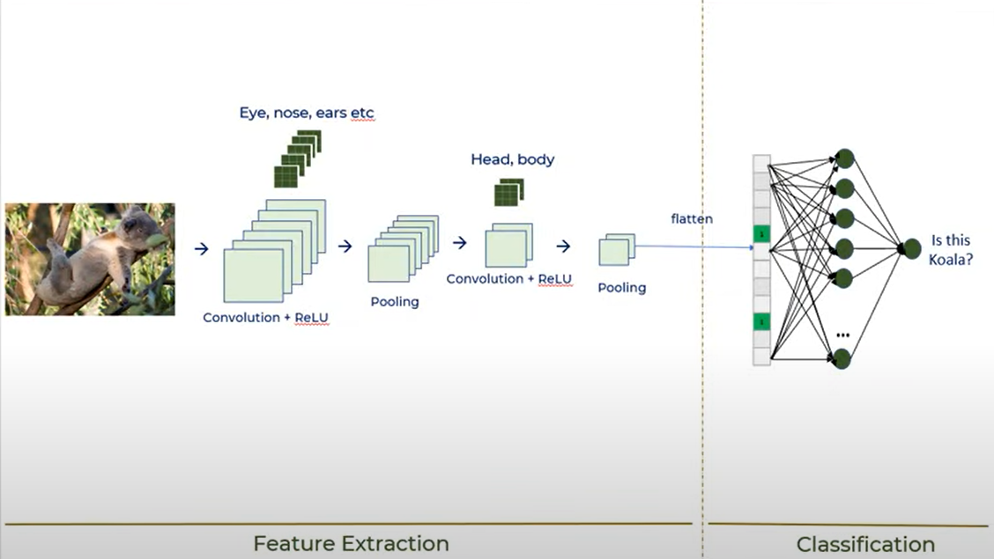

Slide 34
Popular Image Classification Models
Model | Key Features | Best For
AlexNet | First deep CNN, 8 layers | General image classification
VGGNet | 16-19 layers, uniform filters | High accuracy but slow
ResNet | Uses residual connections | Very deep networks
EfficientNet | Balances accuracy and efficiency | Lightweight applications

Slide 35
https://www.youtube.com/watch?v=7HPwo4wnJeA
https://www.youtube.com/watch?v=5QUmlXBb0MY

